Slide 2

Vietnamese stock data collecting and processing
Nguyen Ngoc Khanh - 20204915
Supervisor: Ph.D Nguyen Huu Duc
Notes:
Good morning, honourable members of the committee .
My name is Nguyen Ngoc Khanh, and my thesis is titled Vietnamese stock data collecting and processing.
Before presenting my thesis, I would like to extend my deepest thanks to my supervisor Phd Nguyễn Hữu Đức for
his dedicated guidance that leads to the completion of this thesis.

Slide 3
Outlines
Introduction
Functional requirements
Technologies
Design
Achievement
Conclusion and Future Work
Notes:
The outlines of my presentation contains 6 parts.
Now, We go to the first part Introduction

Slide 4
1. Introduction
Vietnamese stock market:
one of the most popular investments besides real estate, gold, cryptocurrency,...
attracts tremendous amount of newcomers each year
hundreds of thousands of billions dong are poured into the market annually
Technical analysis looks at the price movement and trading volume of a stock and uses this data to predict future price movements.
Technical indicators are heuristic or pattern-based signals produced by the price, volume of a stock.
Notes:
Let’s me introduce you about Vietnamese stock market.
Vietnamese stock market is one of the most popular investments besides real estate, gold, cryptocurrency ,…
It attracts tremendous amount of newcomers each year
And hundreds of thousands of billions dong are poured into the market annually.
To make investing decisions more efficiently, technical analysis is an approach that is popular among the investors and has a history of hundreds of years.
Technical analysis looks at the price movement and trading volume of a stock and uses this data to predict future price movements.
Among the investors who follow technical analysis, technical indicators are heavily used.
Technical indicators are heuristic or pattern-based signals produced by the price, volume of a stock.

Slide 5
1. Introduction
Objectives:
help investors gain more insight into the stock market
enhance investors confidence when participating in trading activities
Data processing system with a web interface:
allows users monitoring the stock market in real-time
provides users the ability to define their own technical indicators
Notes:
With the objectives of helping investors gain more insight into the stock market and enhance investors confidence when participating in trading activities
I decided to build a data processing system with a web interface that allows users monitoring the stock market in real-time
and provide them the ability to define their own technical indicators

Slide 6
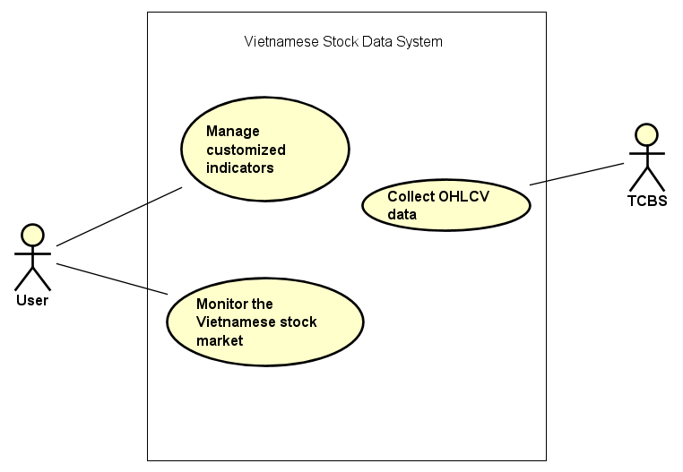
2. Functional Requirements
OHLCV: open high low close volume
TCBS: Techcom Securities
Notes:
My system is called Vietnamese Stock Data System.
User can use my system to manage their customized indicators and monitor the Vietnamese stock market.
My system can also collect OHLCV data from TCBS
OHLCV stands for open high low close volume
TCBS is a shorthand for Techcom Securities which is the source of data

Slide 7
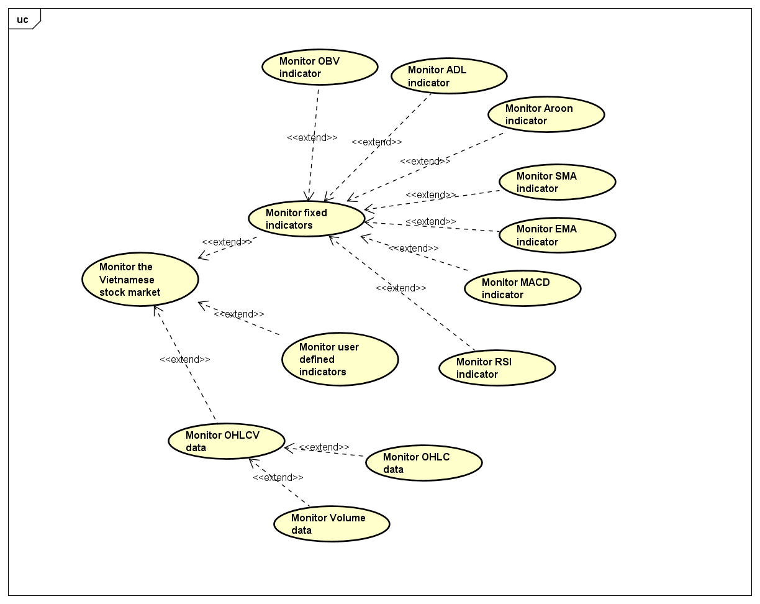
2. Functional Requirements
OBV: On Balance Volume
ADL: Accumulation/Distribution Line
SMA: Simple Moving Average
EMA: Exponential Moving Average
MACD: Moving Average Convergence Divergence
RSI: Relative Strength Index
Notes:
To help users monitor the Vietnamese stock market, my system provides 7 fixed indicators: OBV, ADL, Aroon, SMA, EMA, MACD and RSI.
Moreover, users can monitor their previously defined indicators. About OHLCV data, they are visualized as a candlestick chart and a histogram.

Slide 8
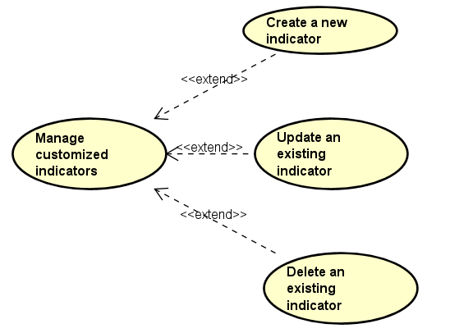
2. Functional Requirements
Notes:
My system supports 3 operations to manage customized indicators: create a new indicator, update an existing indicator and delete an existing indicator.

Slide 9
3. Technologies
Apache Kafka : Distributed event store and stream-processing platform
Apache Druid: Time series database
Streamlit : web development framework
Plotly: making interactive dashboard
Jinja2: template engine to generate python file
Notes:
To build the system, I mainly make use of Apache Kafka as a distributed event store and stream-processing platform.
For the database, I use apache Druid which is optimized for time series data.
I develop web interface using Streamlit.
Plotly is for visualization.
Finally, Jinja2 is a template engine to generate python file

Slide 10
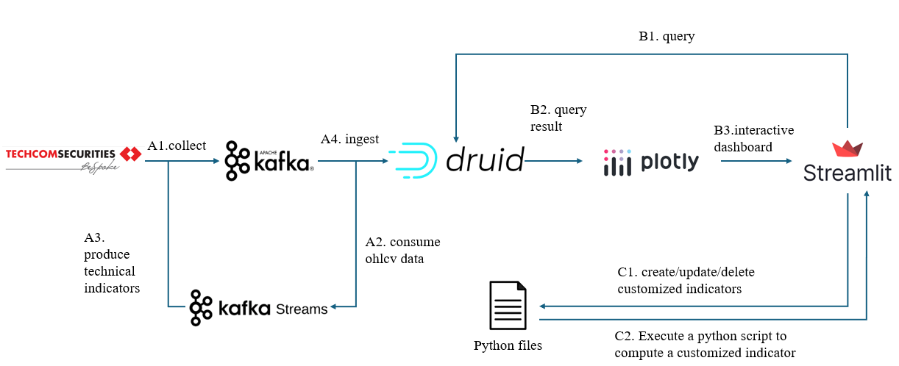
4. Design
Notes:
The figure in the slide shows how different components of the system are connected and three main system flows.
The collecting, computing indicators and storing flow is denoted by the letter A. The stock data are first collected from Techcom Securities and are produced to a Kafka topic.
Let’s me call that topic StockPrices. Next, Kafka Streams applications cosume data from StockPrices topic, do some computation then produces technical indicators value to Kafka.
Finally, Druid ingests all data from Kafka to store securely.
The dashboard generating flow is denoted by the letter B. As the user interacts with the dashboard, the streamlit front-end frequently calls the back-end api to get data from druid. The data are then visualized by plotly python package and the resulting interactive plots are shown in the dashboard.
The manage customized indicators flow is denoted by the letter C and the detail of this flow, I’m going to describe in the next slide

Slide 11
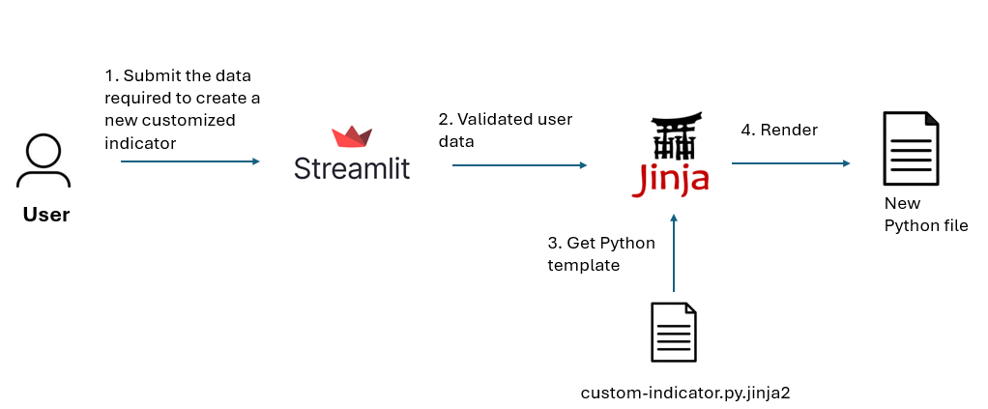
4. Design
Notes:
The user first submit the data required to create a new customized indicator. The input data are then validated by the Streamlit application. The jinja2 engine combines the validated data with the predefied python template custom-indicator.py.jinja2 to create a new python file. The resulted file is able to calculate an user defined indicator.

Slide 12
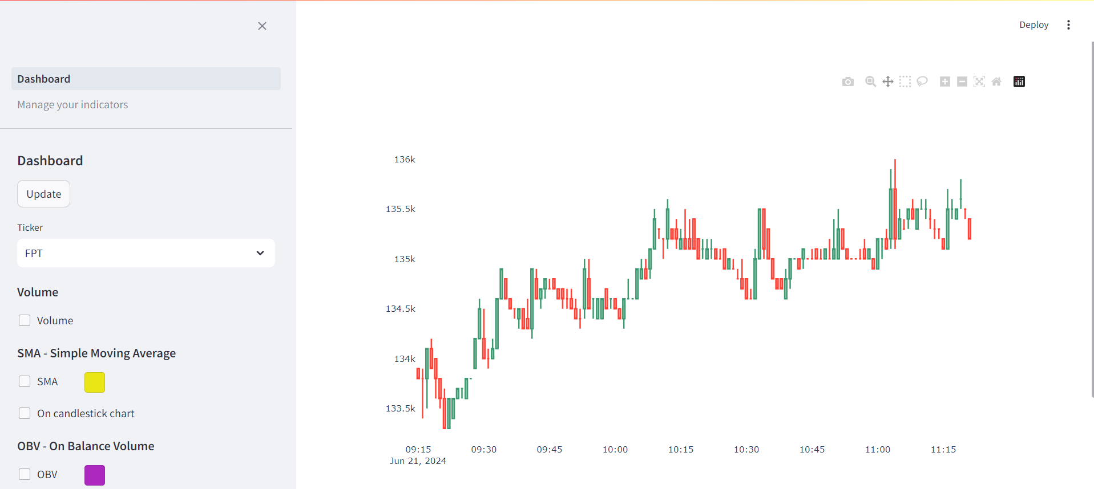
5. Achievement
Notes:
Now, I am going to present the achievement of the implementation of the design in part 4. Here is the initial user interface of my webpage, In the left hand side is the sidebar where user can switch between 2 pages Dashboard and Manage your indicators or configure the appearance of the dashboard. In the right hand side is the dashboard which currently shows the candlestick chart of the FPT stock.

Slide 13
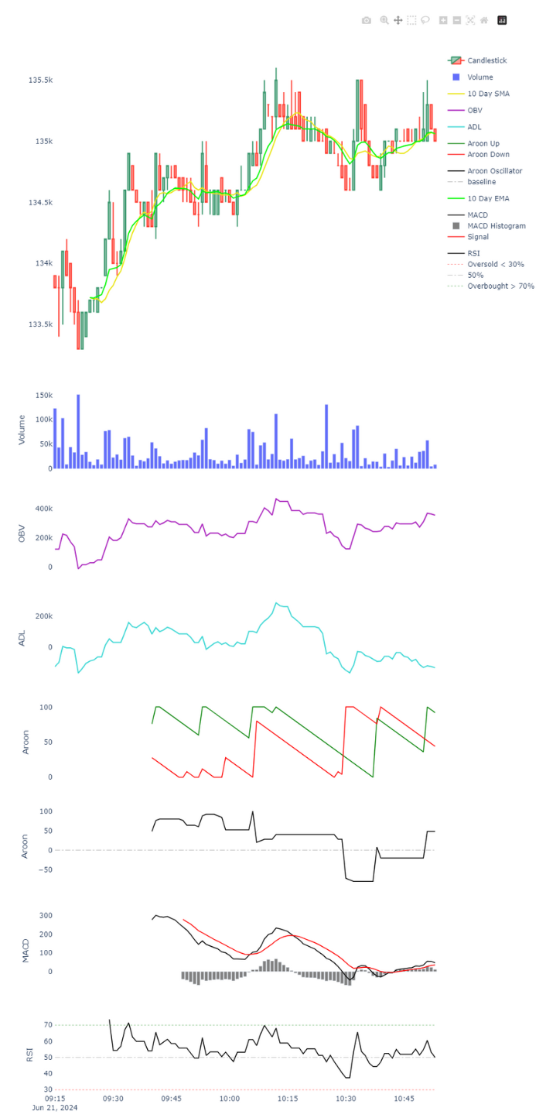
5. Achievement
Notes:
In this slide and the following slide shows what happens when user enables all the fixed indicator visualizations and volume histogram.
Here we can see the 10 day SMA and 10 day EMA lines on the candlestick chart, the volume histogram and the obv line chart

Slide 14
5. Achievement
Notes:
Here are the visualizations of the remaining indicators: ADL, Aroon, MACD and RSI

Slide 15
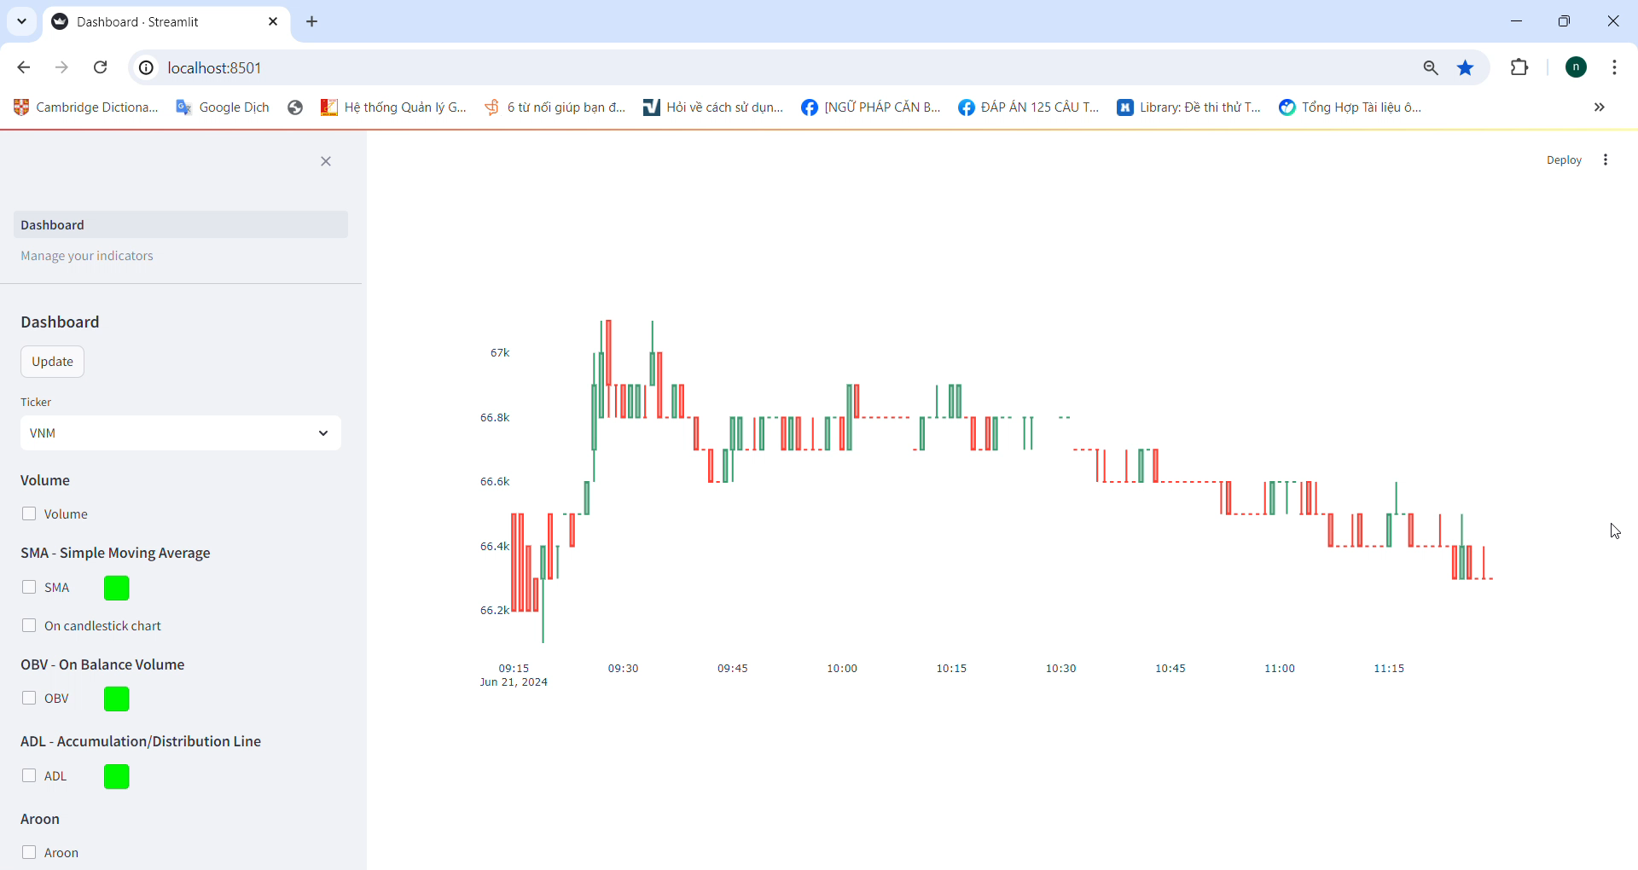
5. Achievement
Notes:
Now is the demonstration of how a user creates a technical indicator named double ema

Slide 16
5. Conclusion and Future Work
The system can receive stock data in real-time, store data securely, calculate famous technical indicators and demonstrate them as an intriguing dashboard.
Advanced users, who have prior experience in Python programming language, would find the system more useful with the manage customized indicators functionality.
Future works:
authenticating users
defining trading strategies
backtesting trading strategies
forcasting future stock prices using machine learning models
Notes:
After testing the system, I have drawn a conclusion: The system can receive stock data in real-time, store data securely, calculate famous technical indicators and demonstrate them as an intriguing dashboard. Advanced users, who have prior experience in Python programming language, would find the system more useful with the manage customized indicators functionality.
In the future, I find that some functionalities that worth developing to add value to the system such as the system has the ability to authenticate users, users can define their own trading strategies and then backtest them, the system can forecast future stock prices using machine learning models.

Slide 17
THANK YOU !
Notes:
That is the end of my presentation.
Thank you for listening.
If you have any questions, I am happy to answer them now.

